Slide 1

Telecom Industry Analytics 1) Call Trend Analytics 2) Customer Churn & Retention Analytics 3) HR Diversion & Inclusion Analytics
Name: Srikrishnan Shankar
Organisation: PWC Virtual Internship

Slide 2
Table of Contents
Introduction
Abstract of The Project
Tools and Programming Used
Exploratory Data Analysis (Dashboard)
End Credits

Slide 3
1) Introduction
This is a Virtual Internship Project from the Company PWC, in this project I will be helping the company to solve an important problem.
Fiddling around in Excel sheets just doesn’t suit a digital jedi. The PwC’s Digital Upskilling Academy helps people move from zero to digital hero. PwC is upskilling 284,000 people because the right digital skills make us agile, adaptable and fit for the future.
We use powerful Data Analytics tools to help solve business problems for our clients. Learning to master Power BI is a good first step. By empowering you to identify patterns, risks and opportunities in data, you will work more efficiently. You will be able to clearly visualise the value of data and turn it into convincing, actionable insights.

Slide 4
2) Abstract of the Project
Create a Dashboard in Power Bi for Visualizing relevant KPI's and Metrics in the Datasets provided.
Utilize the resources provided, including Podcasts and Articles, to enhance the understanding of Data Visualization and Upskilling.
Respond to the client requests by providing a well-designed Power Bi Dashboard reflecting to the KPI's.

Slide 5
3) Tools and Software used
SQL – SQL Server Management Studio
Data Visualization – Power Bi

Slide 6
4) Exploratory Data Analysis
Data analysis is the process of inspecting, cleansing, transforming, and modeling data with the goal of discovering useful information, informing conclusions, and supporting decision-making.
Data analysis has multiple facets and approaches, encompassing diverse techniques under a variety of names, and is used in different business, science, and social science domains.
In today's business world, data analysis plays a role in making decisions more scientific and helping businesses operate more effectively.

Slide 7
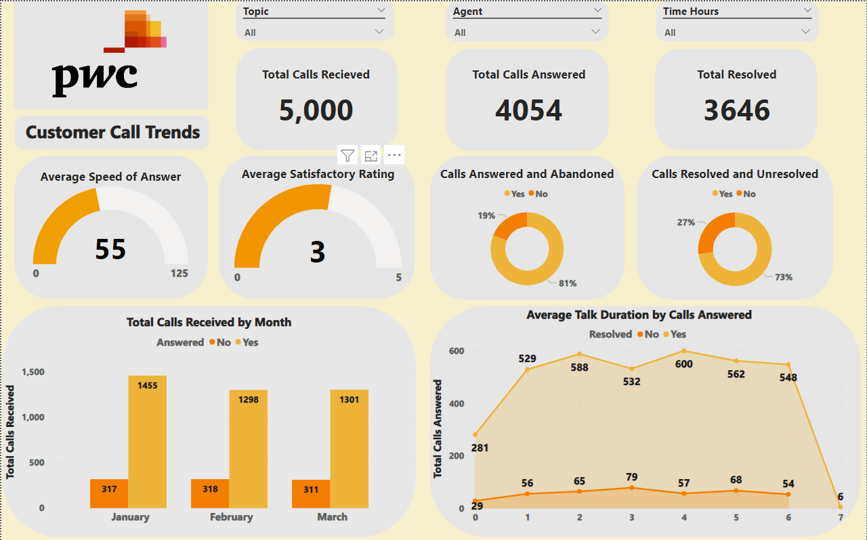
Dashboard 1 : Call Trends

Slide 8
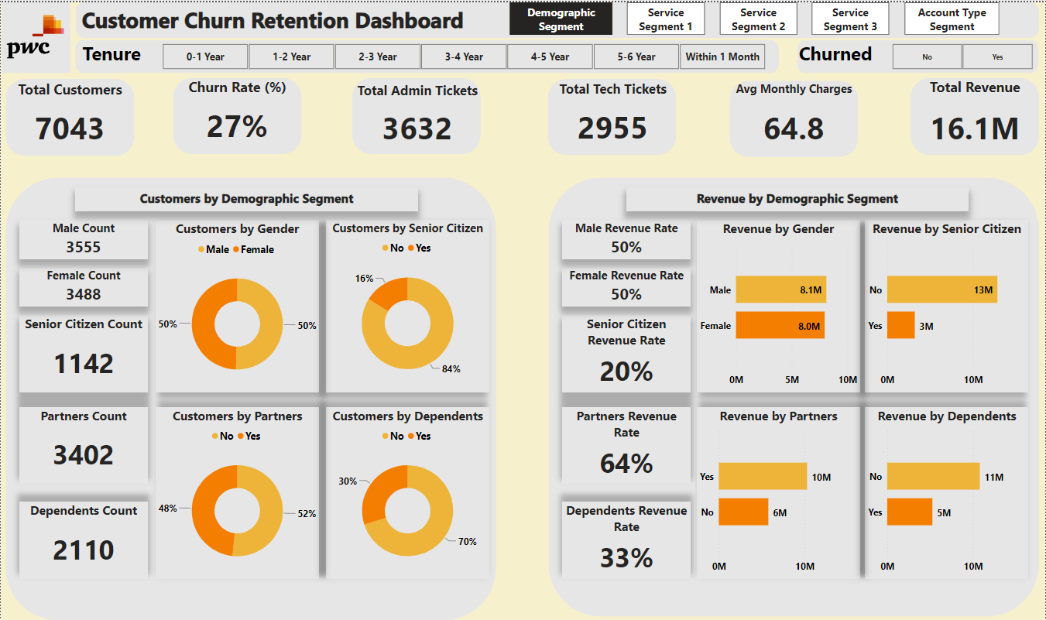
Dashboard 2 : Customer Churn & Retention

Slide 9
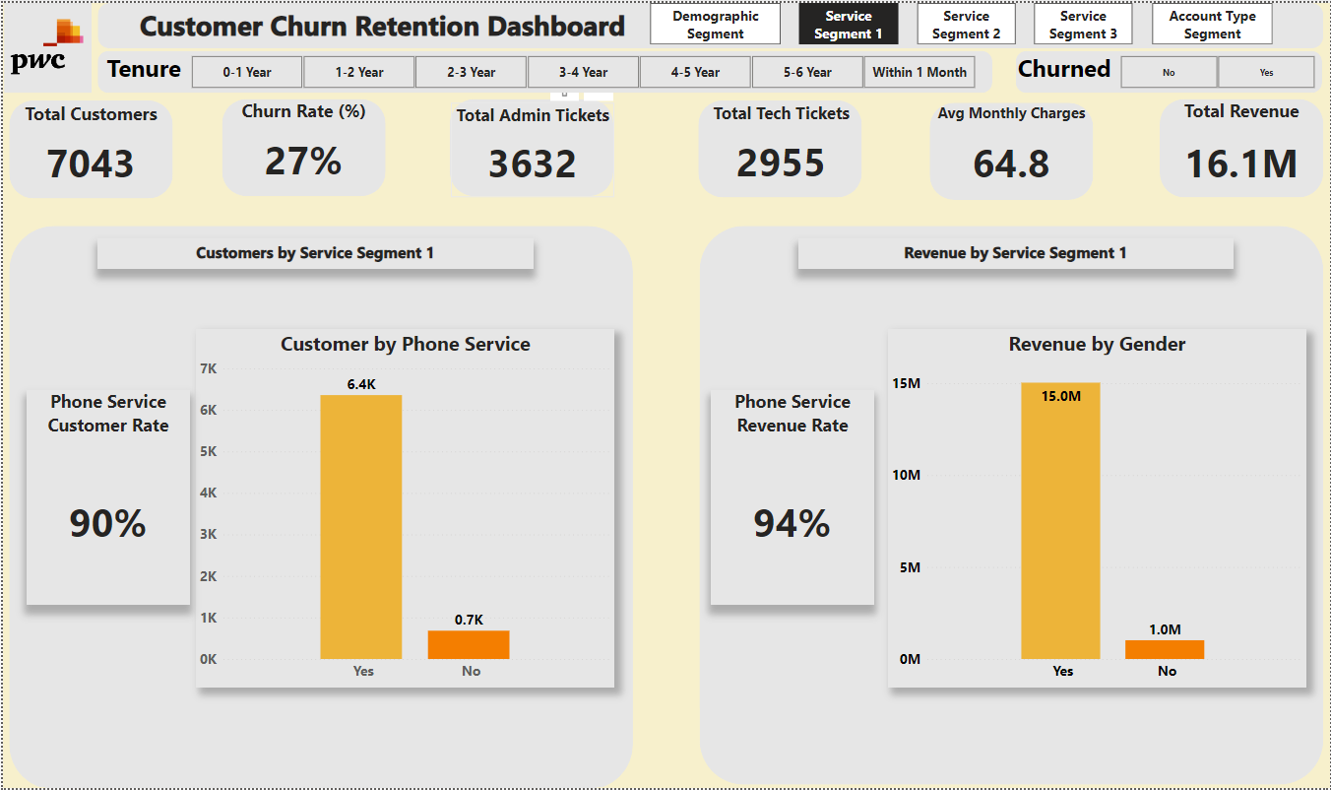
Dashboard 2 : Customer Churn & Retention

Slide 10
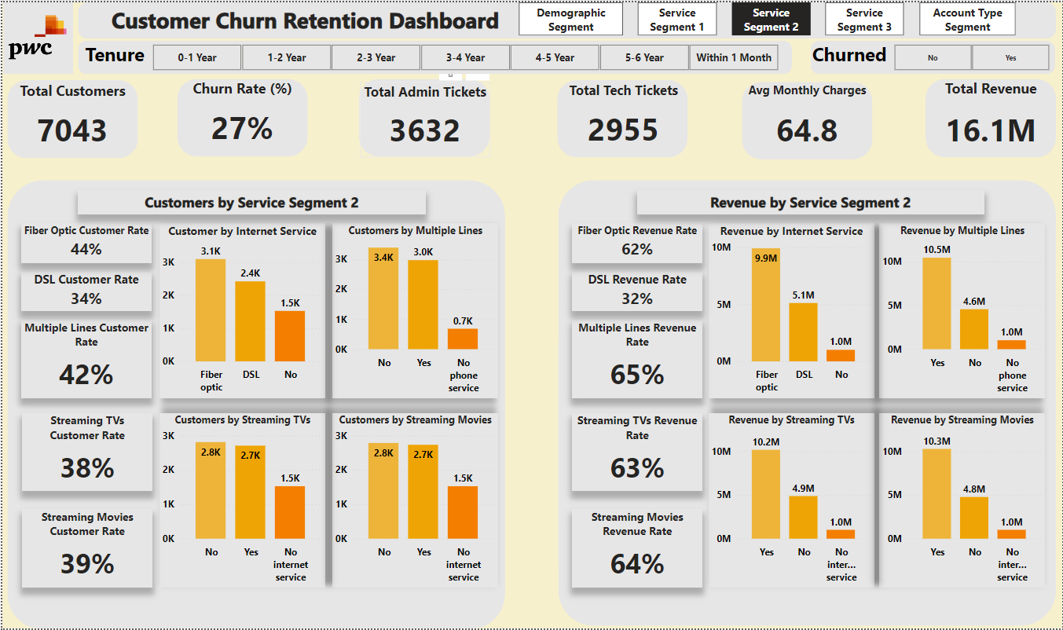
Dashboard 2 : Customer Churn & Retention

Slide 11
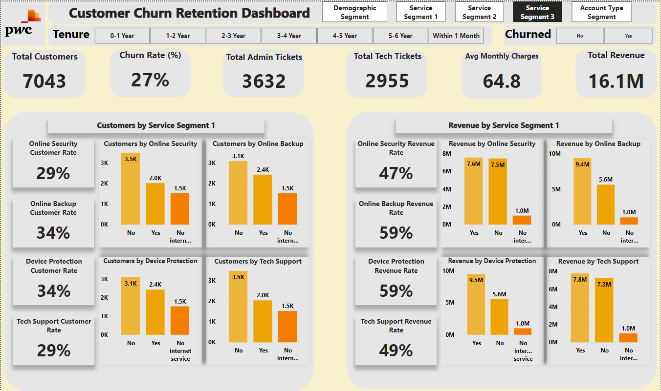
Dashboard 2 : Customer Churn & Retention

Slide 12
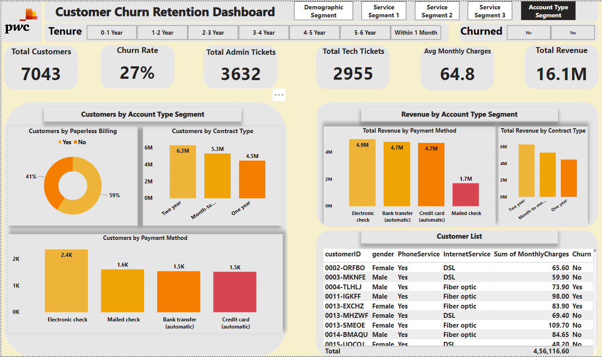
Dashboard 2 : Customer Churn & Retention

Slide 13
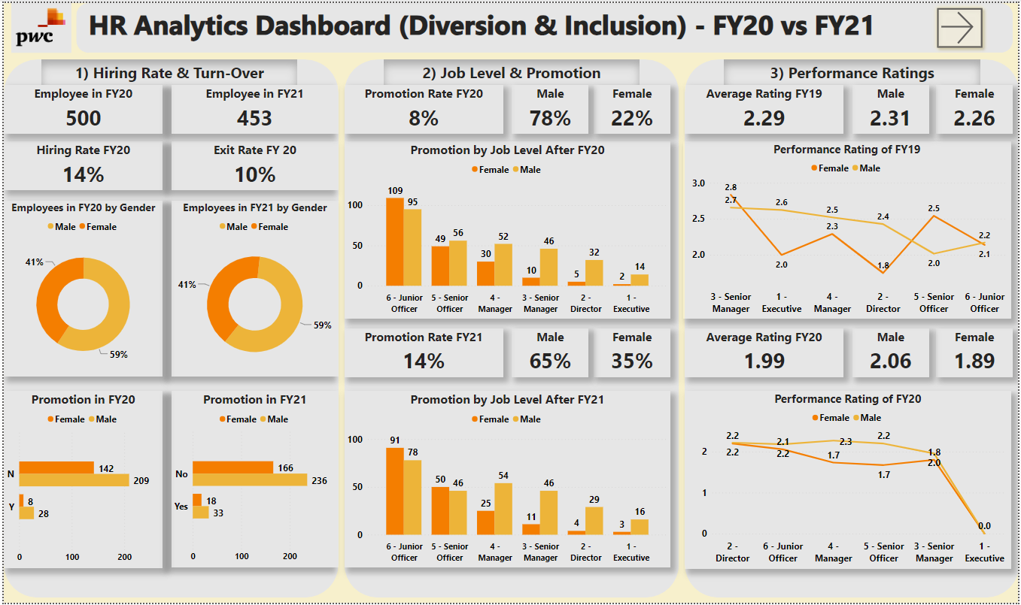
Dashboard 3 : HR Analytics

Slide 14
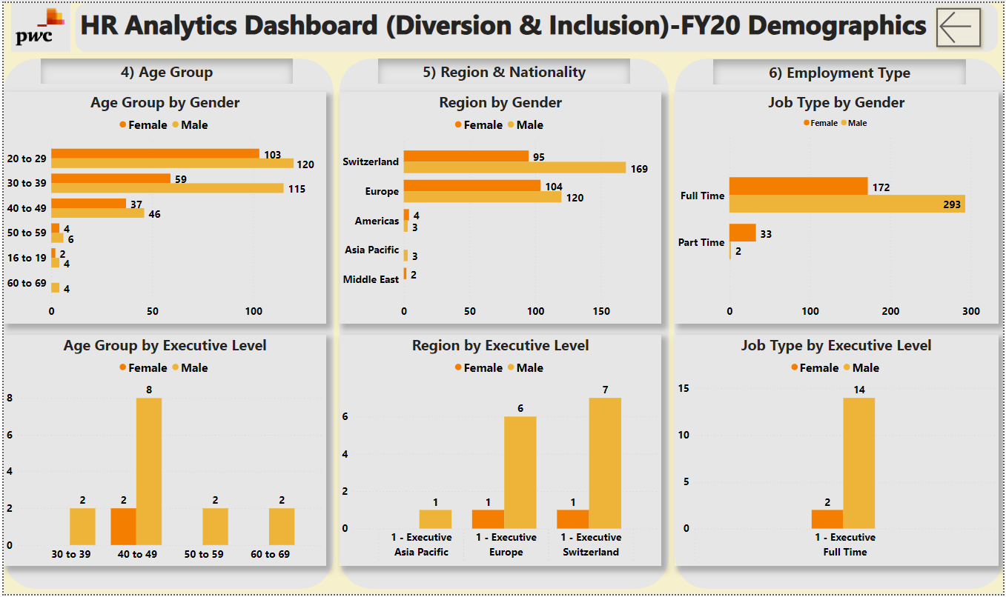
Dashboard 3 : HR Analytics

Slide 15
THANK YOU
Authored by: Name: Srikrishnan Shankar Email: srikrishnan214@gmail.com

